Slide 1


How to register and complete courses in Cognizant Learn

Slide 2
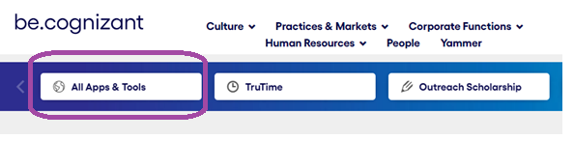
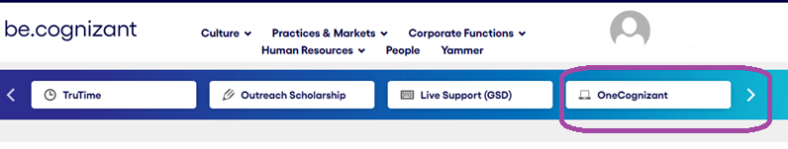
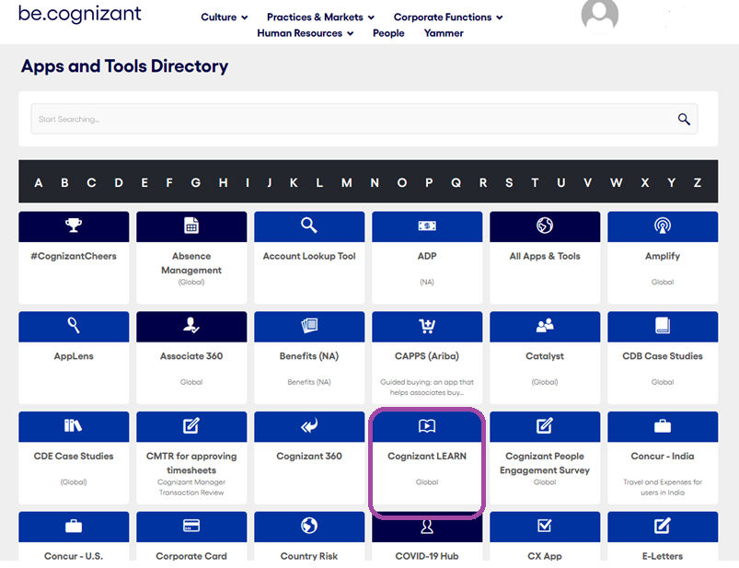
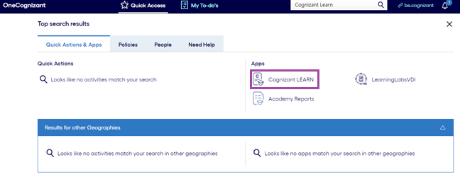
Link to open “be.cognizant”: https://be.cognizant.com/
Select “All Apps & Tools”
Or Select “OneCognizant”
Select Cognizant LEARN from the listed icons
Type Cognizant LEARN in the Search option

Slide 3
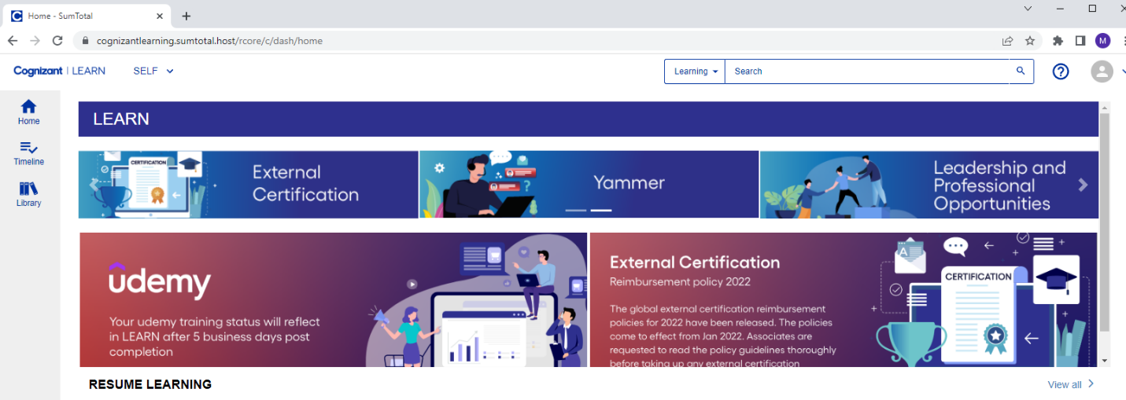
Step 1 - Open LEARN from the link :
https://cognizantlearning.sumtotal.host/Core/dash/home

Slide 4
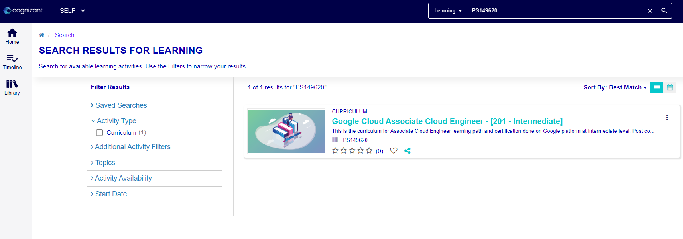
Step 2 - Search for the curriculum code : PS149620

Slide 5


Step 3 - Register for the curriculum code.

Slide 6
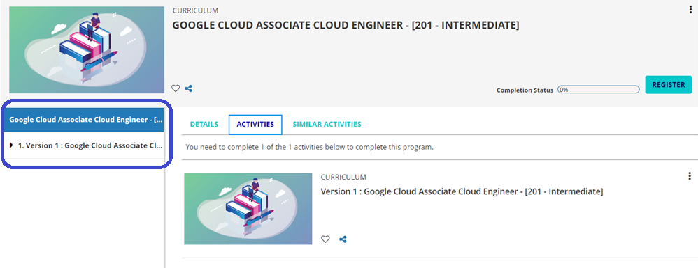

Step 4 - Once you register, the below page will appear. Click on under Certification name

Slide 7
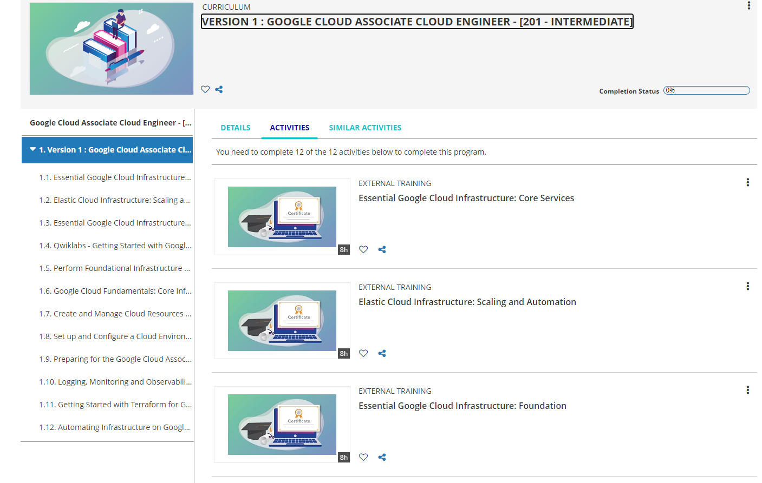
Step 5 - All the courses will appear in the list as shown in the image below.

Slide 8

Step 6 - Click on Start next to each activity to begin learning.

Slide 9
Thank you

